Slide 1
SELENIUM

Slide 2
Automation Testing tools which are used for functional automation:
Quick Test Professional, provided by HP.
Rational Robot, provided by IBM.
Coded UI, provided by Microsoft.
Selenium, open source.
Auto It, open Source.

Slide 3
Automation Testing tools which are used for non-functional automation:
Load Runner, provided by HP.
JMeter, provided by Apache.
Burp Suite, provided by PortSwigger.
Acunetix, provided by Acunetix.

Slide 4
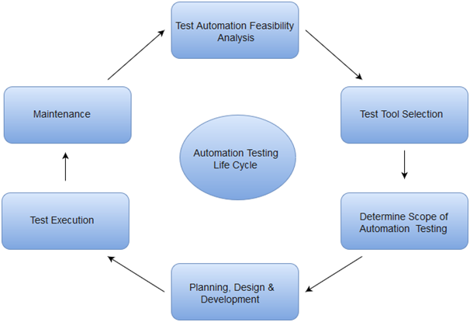

Slide 5
Selenium is an open-source,
automated testing tool
used to test web applications across various browsers.
Selenium can test web applications against various browsers like Firefox, Chrome, Opera, and Safari,
and these tests can be coded in several programming languages like Java, Python, Perl, PHP, and Ruby.
It is platform-independent, meaning it can deploy on Windows, Linux, and Macintosh, and can be integrated with tools like JUnit and TestNG for test management

Slide 6
Selenium can be integrated with frameworks like Ant and Maven for source code compilation.
Selenium requires fewer resources as compared to other automation test tools.
It can be considered as the leading cloud-based testing platform which helps testers to record their actions and export them as a reusable script with a simple-to-understand and easy-to-use interface.

Slide 7
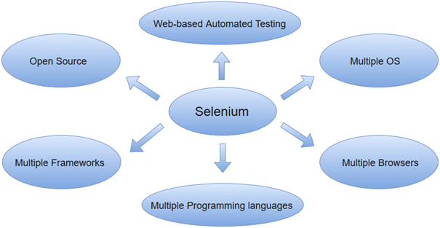

Slide 8
Applications of Selenium Tutorial

Slide 9
Selenium is an exceptional testing tool with high testing exposure and precision. Here are some of the most common applications of Selenium 1. Automated Testing
Selenium removes the need for manual testing by automating regression tests.
This saves testers several days of effort that goes into manually testing every functionality of the software whenever a change is made to the source code.

Slide 10
2. Support for Multiple Browsers
Selenium is one of the few testing tools that support a wide range of browsers. It can support all the recent versions of Google Chrome, Internet Explorer, Opera, Safari, and Mozilla Firefox

Slide 11
1. What is Selenium?
Selenium is currently one of the best and most reliable automation testing tools available out there. Selenium is an automation tool and portable software testing tool for web applications. A test domain-specific language is also provided, to write test cases one can use programming languages, including C#, Java, Perl, PHP, Python, Ruby, Scala, Groovy. It does not support RIA(Rich Internet Application) Technology such as Silverlight JavaFX and Flex\Flash. Selenium is not a single tool. It is a product suite of software consisting of the following components:

Slide 12
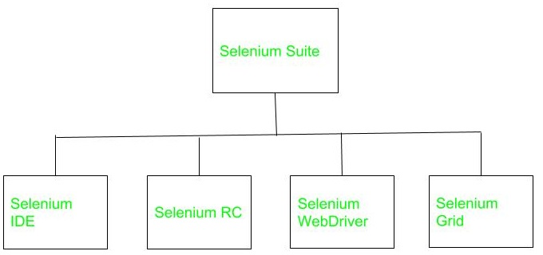

Slide 13
HISTORY

Slide 14
SELENIUM
Selenium was developed by Jason Huggins in 2004 at ThoughtWorks.
He was working on an internal/web application at ThoughtWorks after some time he noticed that instead of testing his application manually, he can automate his testing.
He developed a JavaScript program to test his web application, allowing him to automatically rerun tests.
He called his program “JavaScriptTestRunner”. After some time this tool was open-sourced and renamed as Selenium Core.

Slide 15
Selenium Remote Control(RC )
Selenium Remote Control was developed by Paul Hammant.
The reason behind developing Selenium RC was testers who are using Selenium core had to install the whole application under test and the web server on their local computers because there were some restrictions forced by the same-origin policy.
To overcome this restriction Paul Hammant came to a decision and developed a server that will act as an HTTP proxy to trick the web browser, so that thinks that Selenium Core and the web application being tested came from the same domain.

Slide 16
Selenium IDE
Selenium IDE was developed by Shinya Kasatani of Japan.
It was implemented as a Firefox add-on/plugin and now we can use Selenium IDE on every web browser.
He gave Selenium IDE to the Selenium project in 2006.

Slide 17
Selenium Grid
Selenium Grid was developed by Philippe Hanrigou in 2008.
It is a server that allows the test to use web browser instances running on remote machines.
It provides the ability to run the test on a remote web browser, which helps to divide a load of testing across multiple machines and it will save enormous time.
It allows executing parallel tests across different platforms and operating systems.
Grid provided, as open-source, a similar capability to the private Google cloud for Selenium RC.

Slide 18
Selenium WebDriver
Selenium WebDriver was developed by Simon Stewart in 2006.
WebDriver automates and controls initiated by the web browser.
It does not rely on JavaScript for automation.
It controls the browser directly by communicating with it.
It was the first cross-platform testing framework that could control the browser from the OS level.
In 2009, after a meeting whole Selenium team decided to merge the two projects Selenium RC and WebDriver, and call it Selenium 2.0.

Slide 19
EXPLANATION

Slide 20
Selenium IDE

Slide 21
Selenium IDE
At the beginning Selenium IDE( Integrated Development Environment ) was implemented as a Firefox add-on/plugin and now it can be used Selenium IDE on every web browser. It provides record and playback functionality. The figure shows Selenium IDE.

Slide 22
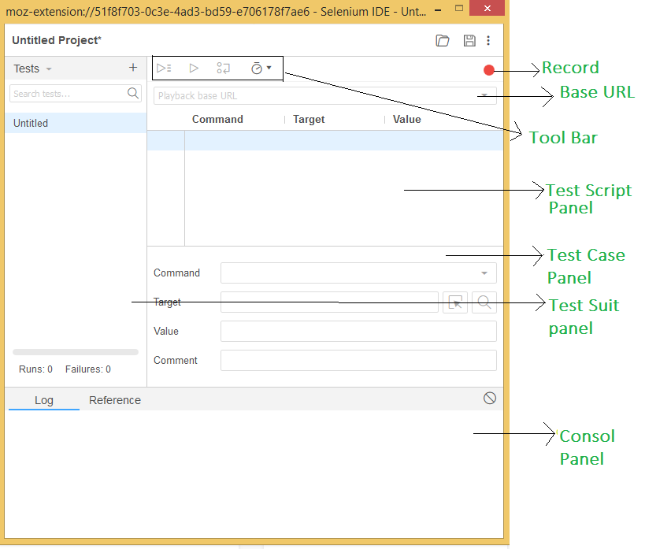

Slide 23
Pros:
It is an open-source tool.
Provide base, for extensions.
It provides multi-browser support.
No programming language experience is required while using Selenium IDE.
The user can set breakpoints and debug.
It provides record and playback functions

Slide 24
Cons:
There are no support iteration and conditional operations.
Execution is slow.
It does not have any API.
It does not provide any mechanism for error handling.

Slide 25
Selenium RC

Slide 26
Selenium RC
RC stands for Remote Control.
It allows the programmers to code in different programming languages like C#, Java, Perl, PHP, Python, Ruby, Scala, Groovy.
The figure shows how the Remote Control Server works.

Slide 27
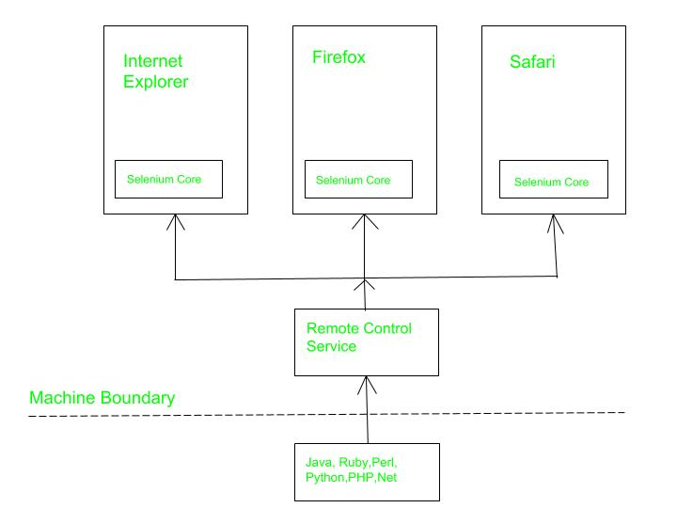

Slide 28
Pros:
It supports all web browsers.
It can perform iteration and conditional operations.
Execution is faster as compared to IDE.
It has built-in test result generators.
It supports data-driven testing.
It has a matured and complete API.

Slide 29
Cons:
Programming language knowledge is needed.
It does not support testing for IOS/Android.
It is a little slower than Selenium Webdriver in terms of execution.
It does not support record and playback functions.
Complicated configuration.

Slide 30
Selenium Web Driver

Slide 31
Selenium Web Driver
Selenium Web Driver automates and controls initiated by the web browser.
It does not rely on JavaScript for automation.
It controls the browser directly by communicating with it.
The figure shows how web driver works as an interface between Drivers and Binding

Slide 32
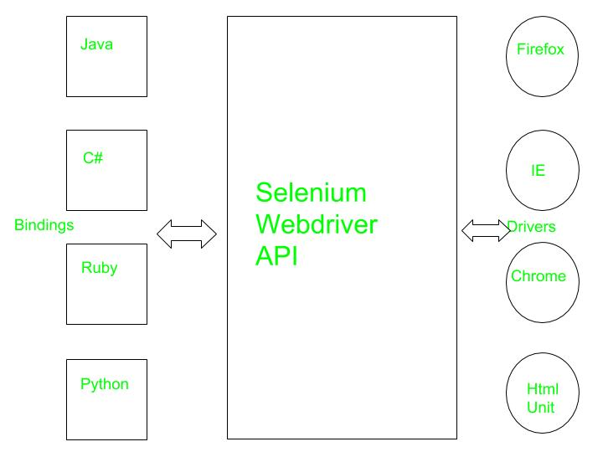

Slide 33
Pros:
It directly communicates with the web browser.
Execution is faster.
It supports listeners.
It supports IOS/Android application testing.
Installation is simpler than Selenium RC.
Purely object-oriented.

Slide 34
Cons:
It requires programming knowledge.
There’s no built-in mechanism for the generation of the test result file.

Slide 35
Selenium Grid

Slide 36
Selenium Grid
Basically, it is a server that allows the test to use a web browser instance running on remote machines.
It provides the ability to run the test on a remote web browser, which helps to divide a load of testing across multiple machines and it will save enormous time.
It allows executing parallel tests across different platforms and operating systems.

Slide 37
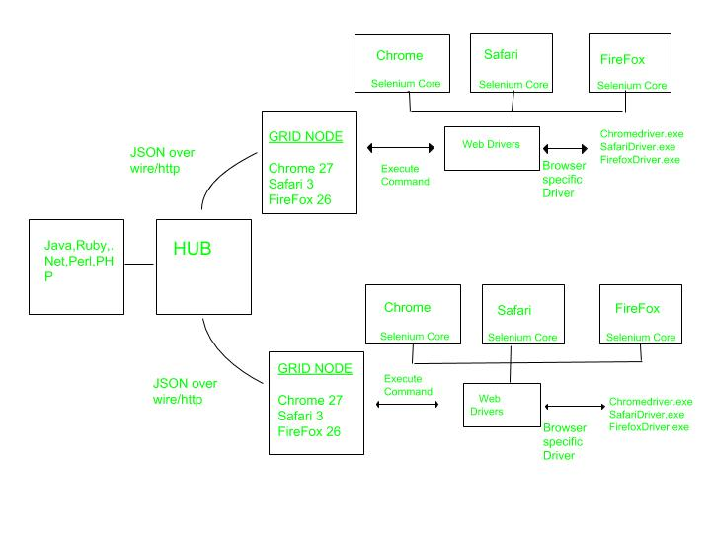

Slide 38
Selenium Grid is a network of HUB & nodes.
Each node registers to the HUB with a certain configuration and HUB is aware of the browsers available on the node.
When a request comes to the HUB for a specific browser [with desired capabilities object], the HUB, if found a match for the requested web browser, redirects the call to that particular Grid Node and then a session is established bi-directionally and execution starts.

Slide 39
LIMITATIONS
It is not possible to perform testing on images. We need to integrate Selenium with Sikuli for image based testing.
Selenium does not support automation testing for desktop applications.
Since Selenium is open source software, you have to rely on community forums to get your technical issues resolved.

